Slide 1


The Problem of the
Gateway Course Completion Line
Andrew (Drew) K. Koch, Ph.D., President and Chief Operating Officer
John N. Gardner Institute for Excellence in Undergraduate Education
2019 Texas Conference on Introductory History Courses | American Historical Association - September 21, 2019

Slide 2


About the Gardner Institute
2019 Texas Conference on Introductory History Courses | American Historical Association - September 21, 2019

Slide 3
Session Overview
Delving Into the Data
Inequitable Outcomes – A Historical Context
Current Unjust Practices in Gateway Courses
Ending the Gateway Course Completion Line
2019 Texas Conference on Introductory History Courses | American Historical Association - September 21, 2019

Slide 4

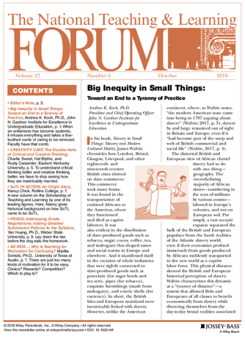
Many Thousands Failed / Inequity in Small Things
2019 Texas Conference on Introductory History Courses | American Historical Association - September 21, 2019

Slide 5
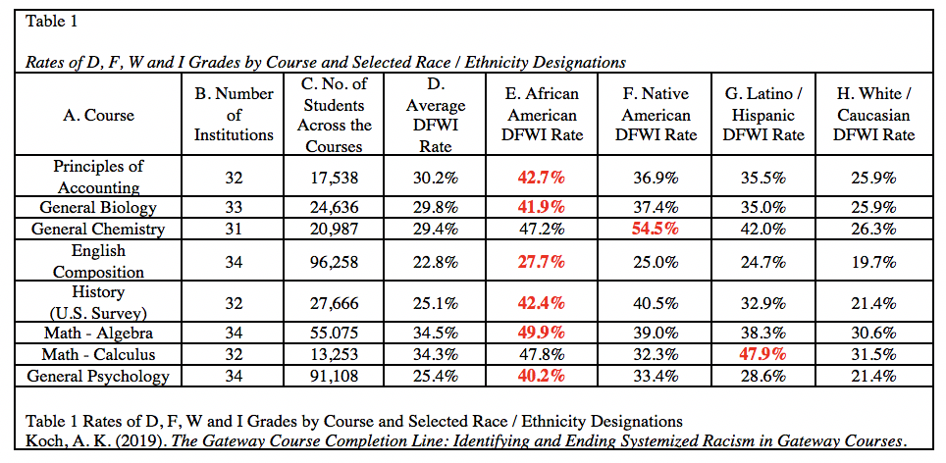
The Gateway Course Completion Line
2019 Texas Conference on Introductory History Courses | American Historical Association - September 21, 2019

Slide 6
The Gateway Course Completion Line
2019 Texas Conference on Introductory History Courses | American Historical Association - September 21, 2019

Slide 7
The Gateway Course Completion Line
2019 Texas Conference on Introductory History Courses | American Historical Association - September 21, 2019

Slide 8
The Gateway Course Completion Line
2019 Texas Conference on Introductory History Courses | American Historical Association - September 21, 2019

Slide 9
The Gateway Course Completion Line
2019 Texas Conference on Introductory History Courses | American Historical Association - September 21, 2019

Slide 10
The Gateway Course Completion Line
2019 Texas Conference on Introductory History Courses | American Historical Association - September 21, 2019

Slide 11
The Gateway Course Completion Line
2019 Texas Conference on Introductory History Courses | American Historical Association - September 21, 2019

Slide 12
The Gateway Course Completion Line
2019 Texas Conference on Introductory History Courses | American Historical Association - September 21, 2019

Slide 13
The Gateway Course Completion Line
2019 Texas Conference on Introductory History Courses | American Historical Association - September 21, 2019

Slide 14
The Gateway Course Completion Line
2019 Texas Conference on Introductory History Courses | American Historical Association - September 21, 2019

Slide 15
The Gateway Course Completion Line
2019 Texas Conference on Introductory History Courses | American Historical Association - September 21, 2019

Slide 16
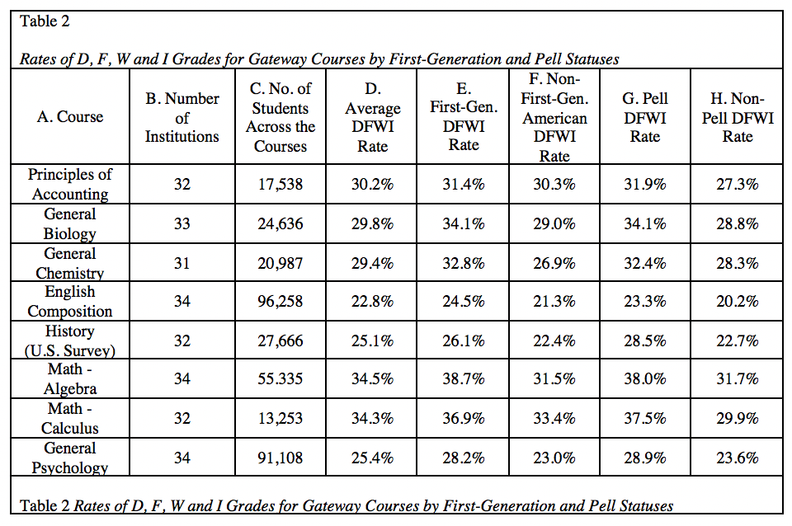
The Gateway Course Completion Line – First Gen
2019 Texas Conference on Introductory History Courses | American Historical Association - September 21, 2019

Slide 17
The Gateway Course Completion Line – First Gen
2019 Texas Conference on Introductory History Courses | American Historical Association - September 21, 2019

Slide 18
The Gateway Course Completion Line - Pell
2019 Texas Conference on Introductory History Courses | American Historical Association - September 21, 2019

Slide 19
The Gateway Course Completion Line - Pell
2019 Texas Conference on Introductory History Courses | American Historical Association - September 21, 2019

Slide 20
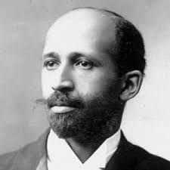
The Gateway Course Completion Line
Are history courses a part of the problem of the gateway course completion line at your institution? Why or why not?
2019 Texas Conference on Introductory History Courses | American Historical Association - September 21, 2019

Slide 21
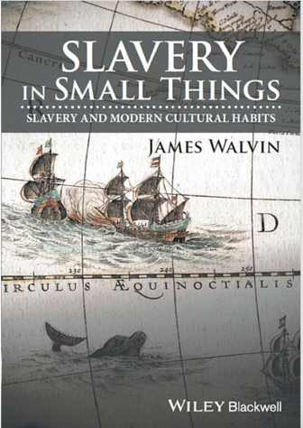
Tyranny of Practice
Tyranny of Distance
  Upholding Slavery and an Unjust Slavery-Based Economy
Tyranny of Practice
  Upholding Unjust, Racialized Outcomes in Courses
2019 Texas Conference on Introductory History Courses | American Historical Association - September 21, 2019

Slide 22
Tyranny of Practice
Lecture
Out-of-Class Support
Grading on Curve
High Stakes / “Merit-Based” Competitive Systems
  Opposed to Mastery / Growth
2019 Texas Conference on Introductory History Courses | American Historical Association - September 21, 2019

Slide 23

Why Change Must Occur
2019 Texas Conference on Introductory History Courses | American Historical Association - September 21, 2019

Slide 24
The Gateway Course Completion Line
2019 Texas Conference on Introductory History Courses | American Historical Association - September 21, 2019

Slide 25

Questions / Discussion
Questions and Discussion
2019 Texas Conference on Introductory History Courses | American Historical Association - September 21, 2019

Slide 26

Contact
Andrew K. Koch
President & Chief Operating Officer
koch@jngi.org
2019 Texas Conference on Introductory History Courses | American Historical Association - September 21, 2019

